Slide 1
Laser Beam Machining (LBM)
A High-Precision Manufacturing Process
SARTHAK P PAI
4CB21AI036

Slide 2

Introduction to LBM
What is Laser Beam Machining?
Definition: LBM is a non-contact machining process using high -
intensity laser beams to remove material.
Key Features:
High precision
Non-contact process
Suitable for hard and brittle materials

Slide 3
Historical Background
1960s: Development of the first lasers.
Evolution: Application in industrial machining began in the late 20th century.
Importance in modern manufacturing.

Slide 4
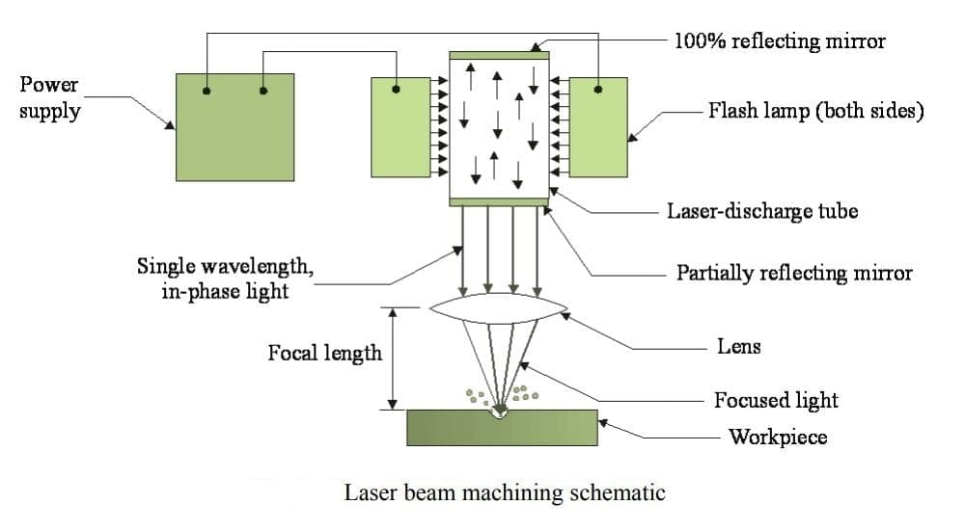
DIAGRAM

Slide 5
Working Principle
Energy Source: Laser generates a focused beam.
Material Removal:
Laser heats the material above its melting/vaporization point.
Material is removed as vapor or molten debris.
Key Steps:
Laser generation
Beam focusing
Material interaction

Slide 6
Components of LBM
Laser Source (e.g., CO2, Nd:YAG, fiber laser)
Optical System (e.g., lenses, mirrors for focusing)
Workpiece
Assist Gas (optional, for debris removal)

Slide 7
Types of Lasers Used
CO2 Lasers: High power, suitable for non-metals.
Nd:YAG Lasers: Precision machining for metals.
Fiber Lasers: Efficient and versatile.

Slide 8
Applications
Aerospace: Drilling cooling holes in turbine blades.
Electronics: Cutting micro-components for circuits.
Medical: Precision cutting in surgical tools.
Automotive: Machining hard materials like ceramics.

Slide 9
Advantages
High precision and accuracy.
Non-contact process reduces tool wear.
Works with hard and brittle materials.
Minimal heat-affected zone (HAZ).

Slide 10
Limitations
High initial setup cost.
Limited material removal rate.
Safety concerns due to intense laser radiation.

Slide 11
Future Trends
Integration with AI and automation.
Advancements in ultra-fast laser systems.
Expanding applications in nanotechnology.

Slide 12
Conclusion
High Precision: Laser Beam Machining (LBM) provides unmatched accuracy and precision for complex manufacturing tasks.
Non-Contact Process: Ensures minimal wear and tear on tools, increasing operational efficiency.
Versatility: Capable of machining hard, brittle, and heat-resistant materials across diverse industries.
Wide Applications: Extensively used in aerospace, electronics, medical devices, and other advanced sectors.
Challenges: High initial costs, energy consumption, and safety concerns need to be addressed.

